Slide 1


Legal Metrology
Compliance Checker
Automated rule-engine for packaged-commodity compliance.
Team Name: [Insert Unique Team Name]
Problem Statement ID: [Insert ID / Title]
SIH 2026 | Bennett University Internal Hackathon

Slide 2

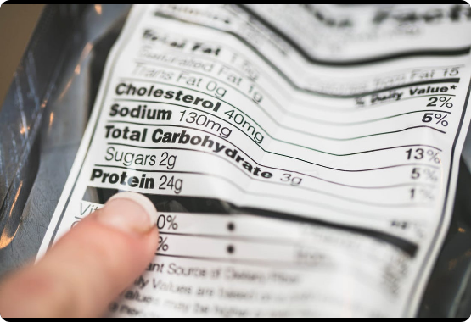
What is Legal Metrology non-compliance?
•
Violates the strict guidelines of Packaged Commodities Rules, 2011.
•
Directly compromises basic consumer protection rights.
•
Current manual QA processes are notoriously slow and inconsistent.
•
Enforcement officials lack scalable, field-ready audit tools.

Slide 3






Who faces this problem?
Enforcement Officials
Brand Compliance Teams
E-commerce Sellers
Need highly scalable, reliable field-inspection tools to verify regulations on site.
Demand rapid pre-listing validation to ensure online catalog compliance.
Require automated pre-shipping QA checks to prevent costly recalls or legal action.

Slide 4
Existing Gap: The Need for Rules-Encoding
No Labeled Dataset: Only raw legal text exists. Traditional supervised ML cannot be trained.
Scale Limitations: Manual audits simply cannot scale with e-commerce volume.
Dynamic Legalities: Rules amend frequently via informal FAQs and departmental circulars.
Conclusion: This requires a flexible rules-encoding architecture, not rigid checklists or black-box ML.

Slide 5

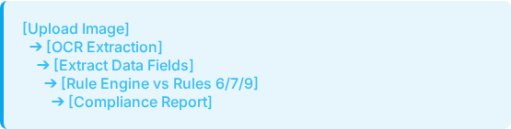
Our Solution
An app that scans a package photo, extracts the mandatory declarations via OCR, and checks them against a versioned digital rulebook, flagging violations instantly.

Slide 6





Innovation: What Makes It Different
Versioned Configs
Font Automation
Rules stored as editable JSON/YAML config, handling future amendments without codebase redeployment.
Automates Rule 7 (minimum font-size-in-mm) via reference-object/dimension calibration—a rule rarely checked manually.
Explainable Engine
Legally Defensible
Deterministic, explainable rule engine. Every single violation traces back to a specific legal clause.
Not a black-box machine learning verdict. Our rule-engine outputs verifiable, legally defensible logic.

Slide 7

Technical Approach & MVP Scope
System Architecture
Image Preprocessing ➔ OCR (Cloud API/PaddleOCR) ➔ Entity Extraction (regex/keyword classification for 6 core declarations) ➔ Rule Engine ➔ Report
Deliberate MVP Choices:
•
Front-panel-only photo analysis.
•
Manual reference-object size calibration.
•
Off-the-shelf reliable OCR integration.

Slide 8




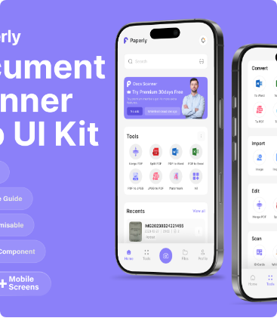
Prototype & Workflow
1. Upload & Scan
2. Results & Validation
3. Download Report

Slide 9









Technology Stack
Frontend
React
Backend
FastAPI / Python
Extraction
OCR API / PaddleOCR
Database
PostgreSQL
Logic
JSON Rule Engine

Slide 10


Validation & Data Approach
Establishing Ground Truth
Our Data Strategy
No public compliance dataset exists for Indian Legal Metrology. Instead of relying on unreliable scraping, we engineered a deliberate methodology to establish exact ground truth for pipeline testing.
•
Manual Set: 15–20 photographed, hand-labeled real products serving as real-world benchmarks.
•
Synthetic Labels: Pillow-generated labels with known-missing/malformed fields to ensure our rule engine catches specific edge cases perfectly.

Slide 11
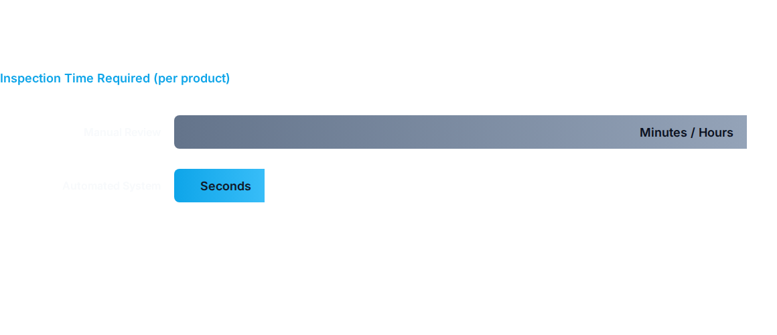
Delivering Real-World Impact
Faster inspections
Fewer brand QA misses
Scalable consumer protection

Slide 12
Future Scope: What We'd Build Next
Classification
Deployment
NER / ML-based field classification beyond regex.
Offline / edge device deployment for remote field inspectors.
Detection
Localization
Principal Display Panel (PDP) auto-detection integration.
YOLO-based region localization & full multilingual support.

Slide 13
Team: [Your Team Name]
Name | Role | Primary Contribution
[Name 1] | Lead Developer | Pipeline architecture & FastAPI setup.
[Name 2] | AI/ML Specialist | OCR integration & Entity Extraction.
[Name 3] | Rule Engineer | JSON Rule-engine logic & compliance mapping.
[Name 4] | Frontend / UI | React dashboard & result visualization.
[Name 5] | Data / QA | Synthetic label generation & ground-truth testing.
[Name 6] | Presenter / Product | Pitch narrative, demo prep & report generation.

Slide 14

Thank You
Ready to automate compliance checking.
[Email / Phone]
[GitHub Link Placeholder]
[YouTube Demo Link - Required for Phase 1]

Slide 15






Image Sources
https://tynerpondfarm.com/cdn/shop/articles/Nutrition-Facts-Label.jpg?v=1743188269&width=1100
Source: tynerpondfarm.com
https://img.magnific.com/premium-photo/concept-software-architecture-microservices-glowing-digital-flowchart-with-connected-nodes-blurred-programming-code-background_372999-53326.jpg
Source: www.magnific.com
https://nextaipress.com/wp-content/uploads/2026/07/ai-career-pathways-glowing-nodes-diagram-1024x652.png
Source: nextaipress.com
https://images.ui8.net/uploads/details-image-1_1768216769240.png
Source: ui8.net
https://www.netdata.cloud/blog/images/custom-dashboards-1.png
Source: www.netdata.cloud
https://template.canva.com/EAG1AaspnFE/1/0/1131w-YBAdmDFqWIc.jpg
Source: www.canva.com

